Slide 1










PVZ

Slide 2

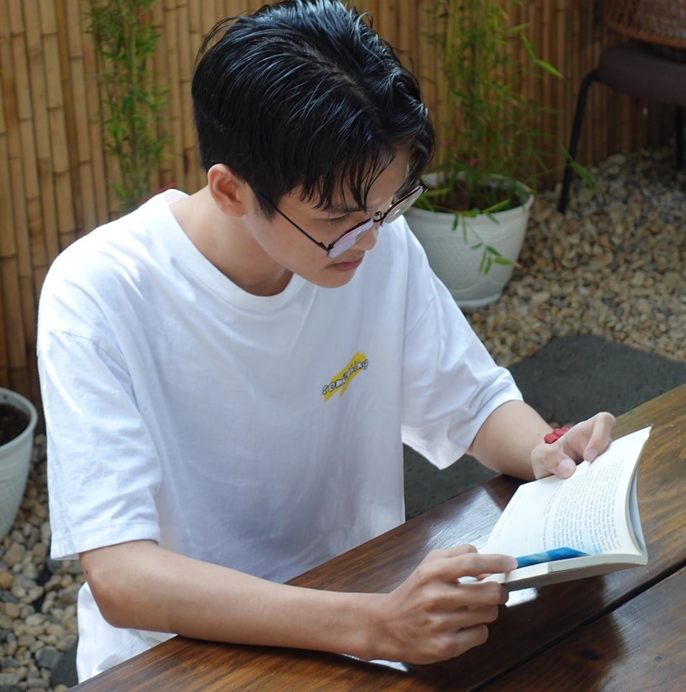



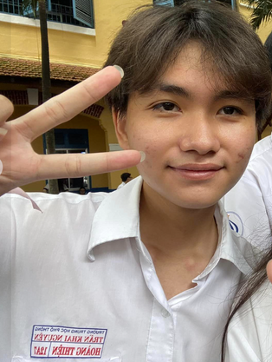

OUR TEAM
Nguyễn Minh Đạt
Hà Anh Khoa
Nguyễn Hải Phú
More Information
More Information
More Information
Đặng Hoàng Nam
Nguyễn Hoàng Thiện
More Information
More Information

Slide 3


NGUYỄN MINH ĐẠT
LEADER

Slide 4
HÀ ANH KHOA
MEMBER

Slide 5
NGUYỄN HẢI PHÚ
MEMBER

Slide 6
ĐẶNG HOÀNG NAM
MEMBER

Slide 7


NGUYỄN HOÀNG THIỆN
MEMBER

Slide 8




01
Abstract
OUR PROJECT
Objective
02
03
Game overview
04
UML
05
Methodology
06
Conclusion
07
References

Slide 9
ABSTRACT
We are developing a game project, “Plant vs Zombies”, for our “Object Oriented Programming” course, which is a four-credit subject in our degree program.
This project was chosen to enhance our development process, improve our Java skills, and apply the theoretical knowledge we’ve learned in class.
Combining the work of teams covering multiple disciplines (art, music, acting, programming, etc.)

Slide 10
OBJECTIVE
Create a 2D platform game using Java.
01
Master Java Programming and implement OOP and SOLID design principles.
02
Resolve issues common in Procedural-Oriented Method by making code transparent, concise, and creating a cohesive logical system.
03
Use the project as a learning tool and a stepping stone for future programming careers.
04

Slide 11
GAME OVERVIEW
01
Characters
02
Items
03
Environment
04
User manual

Slide 12


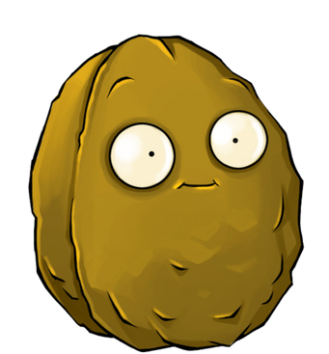
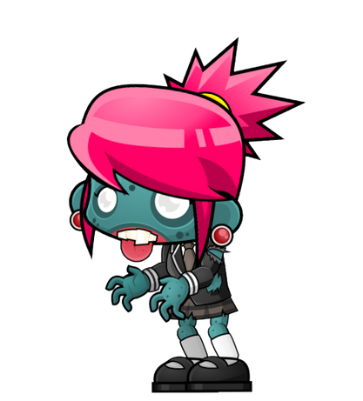
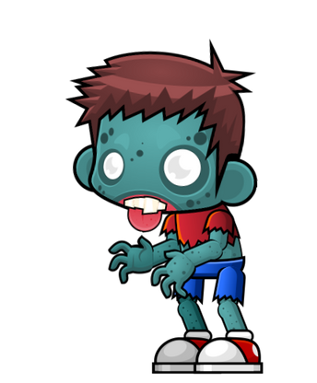
GAME OVERVIEW (CONT)
01
Characters

Slide 13




GAME OVERVIEW (CONT)
02
Items
Sun
Shovel
Bullet
Lawn Mower

Slide 14
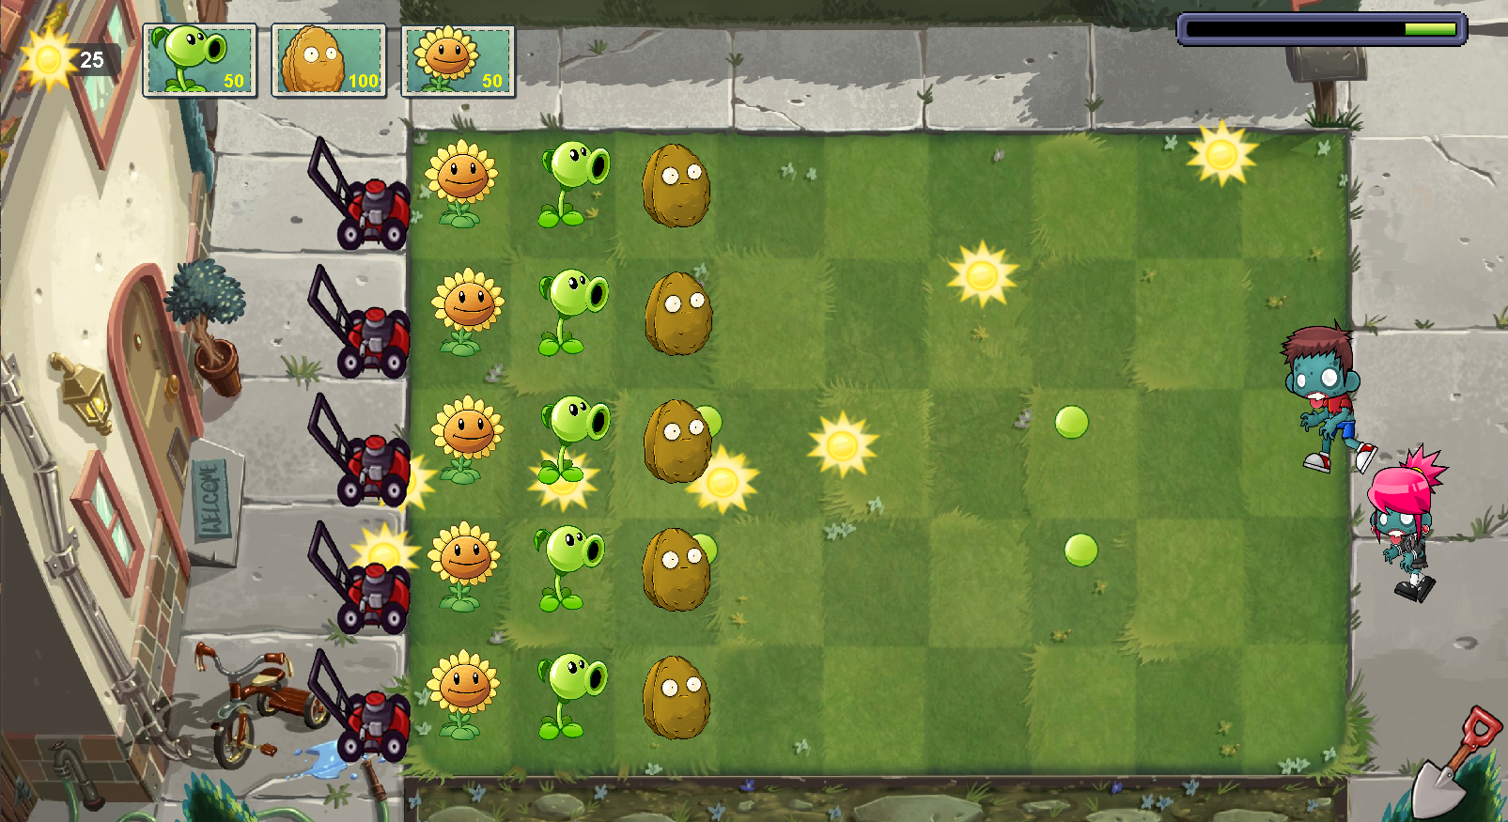
GAME OVERVIEW (CONT)
03
Environment

Slide 15

GAME OVERVIEW (CONT)
03
Environment

Slide 16
GAME OVERVIEW (CONT)
04
User manual
Menu Navigation: Click desired option on menu.
Plant Selection: Click plant icon then desired plant.
Plant Placement: Click desired location on grid to place selected plant.
Sun Collection: Click sun icon to collect.

Slide 17
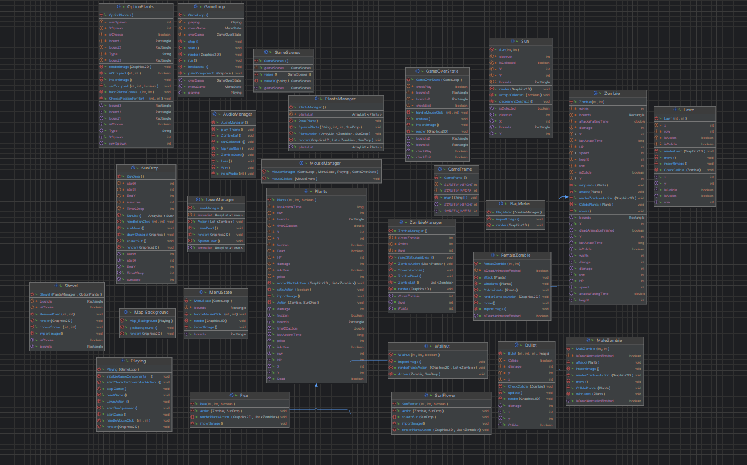

UML

Slide 18

METHODOLOGY
01
Rules
02
Game Instructions
03
Designs

Slide 19
01
Rules
You are the manager, defending your house with 6 lawnmowers as the last resort.
Eliminate zombies (male & female) with 3 plant types (Pea-Shooter, Sunflower, Walnut).
Deploy plants strategically.
Win by killing all the zombies.
Lose by letting zombies reach the house after mowers are gone (Game Over).

Slide 20



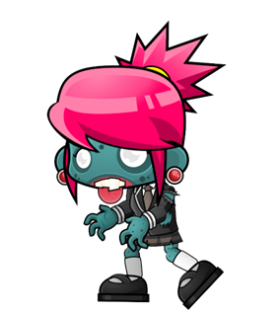
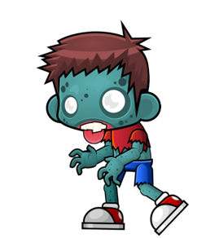

03
Designs UI/UX

Slide 21
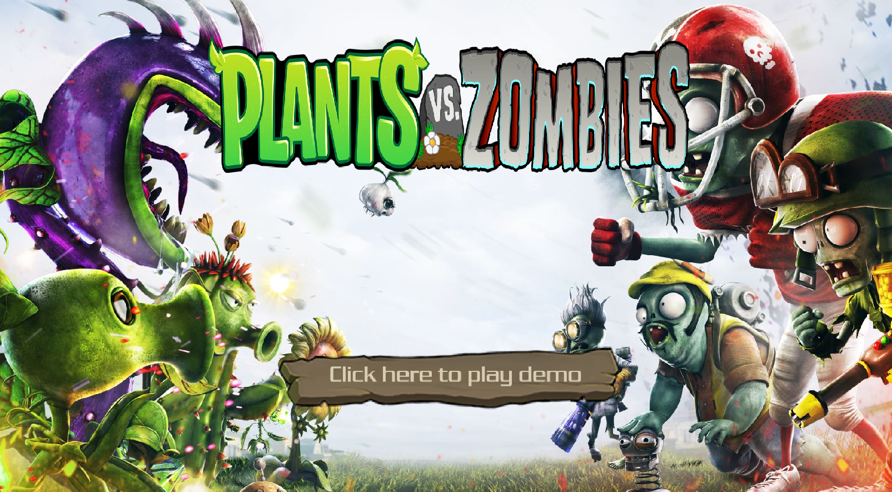
03
Designs UI/UX

Slide 22
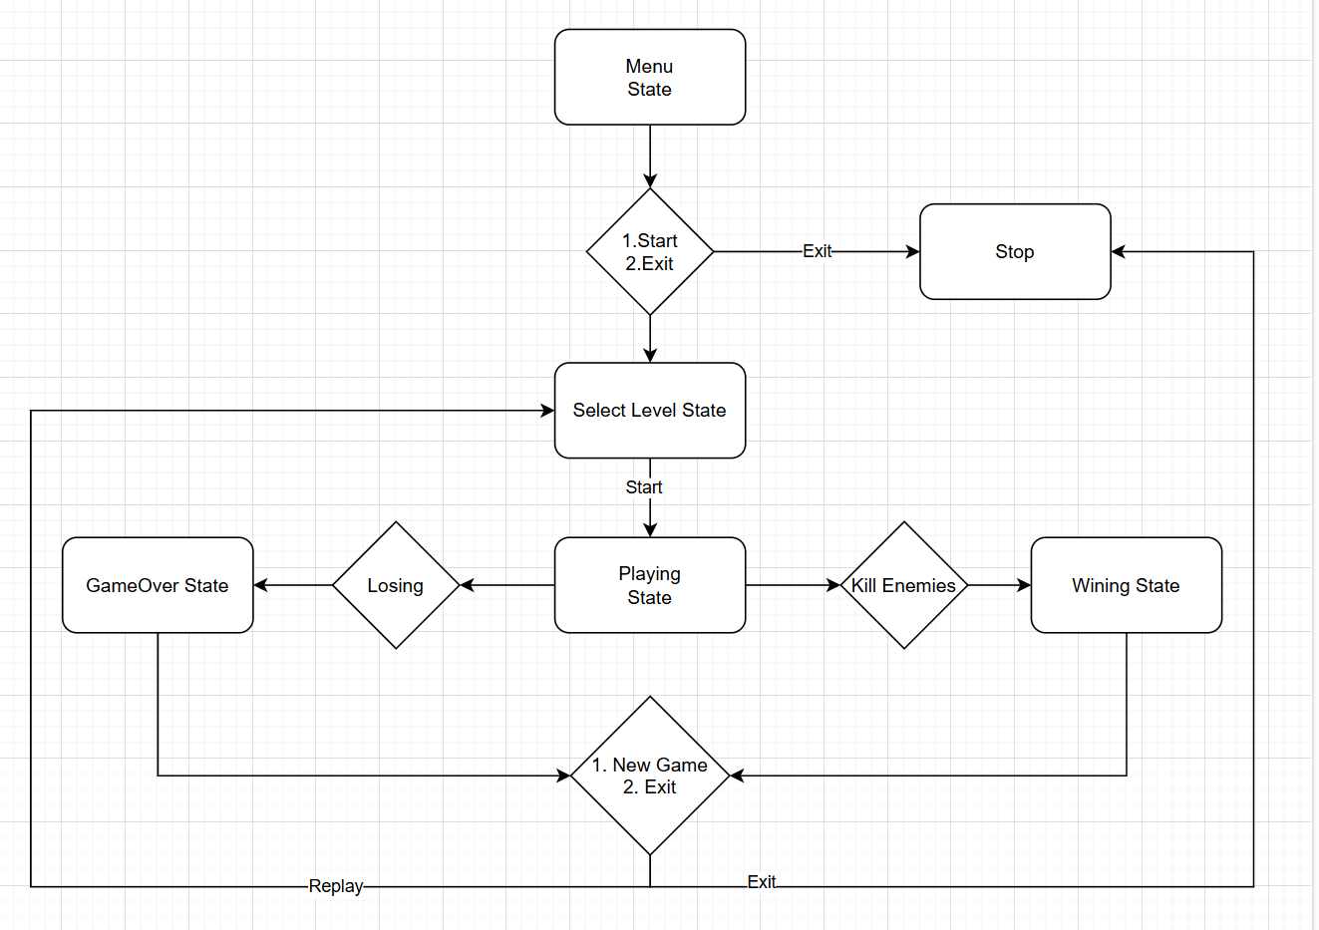
03
Designs Game Loop

Slide 23
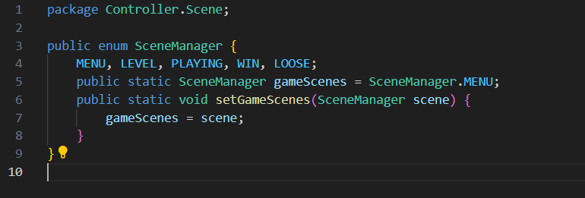
03
Design Patterns
SceneManager: Singleton and State Pattern

Slide 24
03
Design Patterns
Singleton
Only one instance of the Scene Manager exists throughout the game

Slide 25
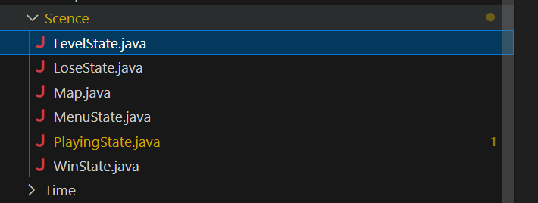
03
Design Patterns
State Pattern
State Pattern: Each Scene is represented by a seperate state class

Slide 26
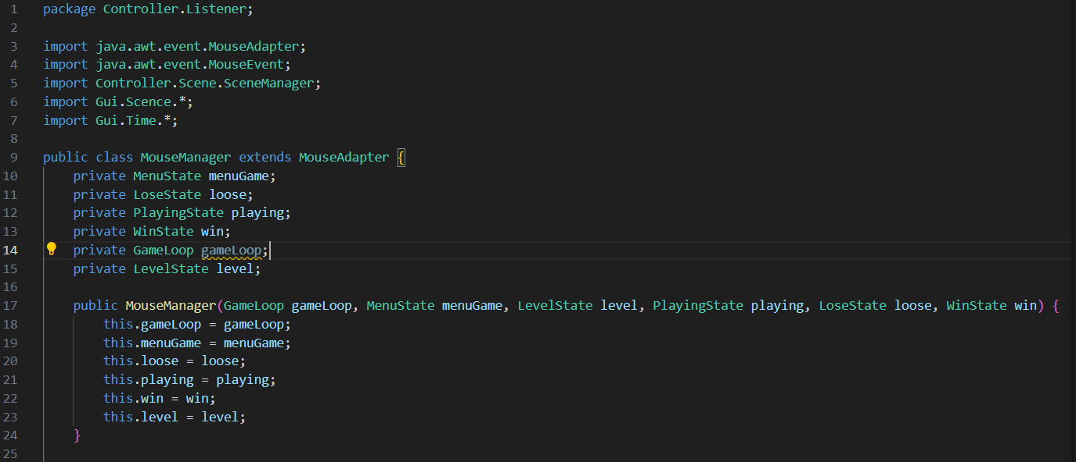
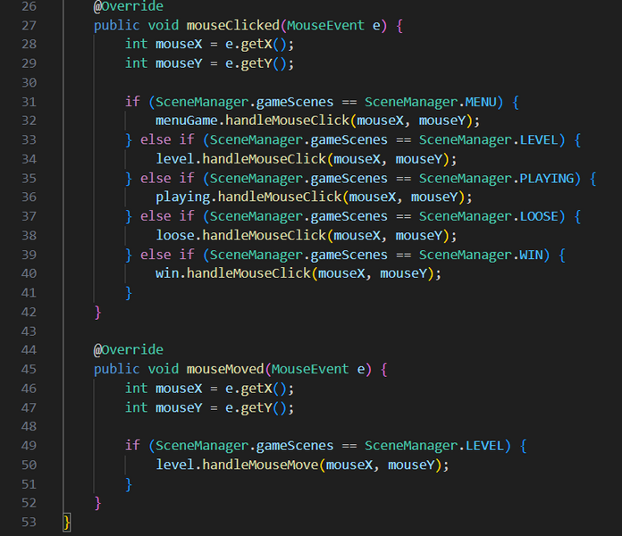
03
Design Patterns
Mouse Manager: Observer Design Pattern

Slide 27
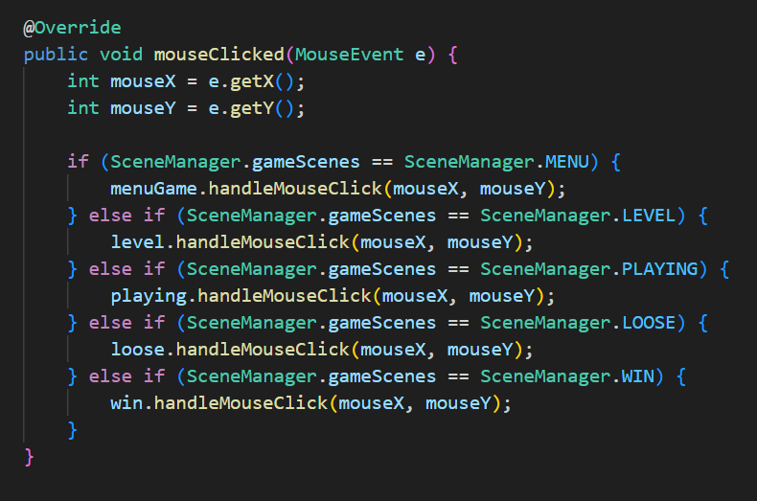
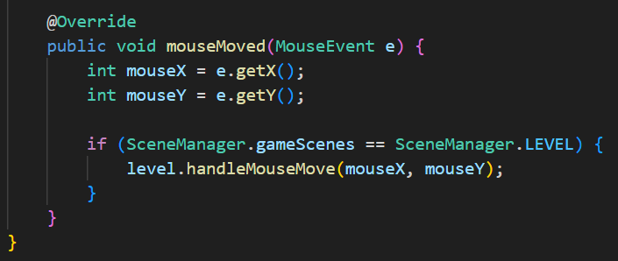
03
Design Patterns
Mouse Manager: Observer Design Pattern
The Mouse Manager extend the Mouse Adapter for handling mouse events, such as clicks and movements.
Notifying other objects in the game that are interested in mouse events.

Slide 28
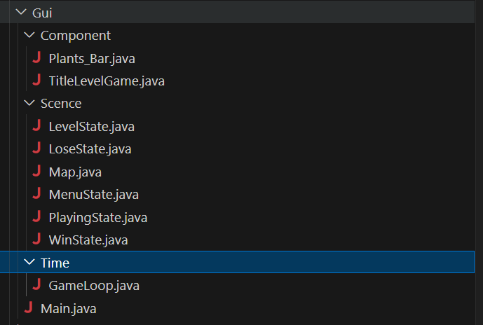
03
Designs: Game Algorithms
We have already group our classes into a specific group, such as:
GUI:

Slide 29
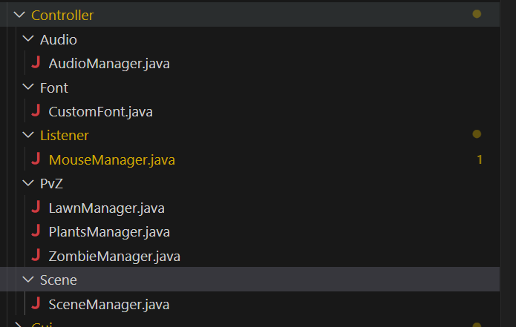
Controller:

Slide 30
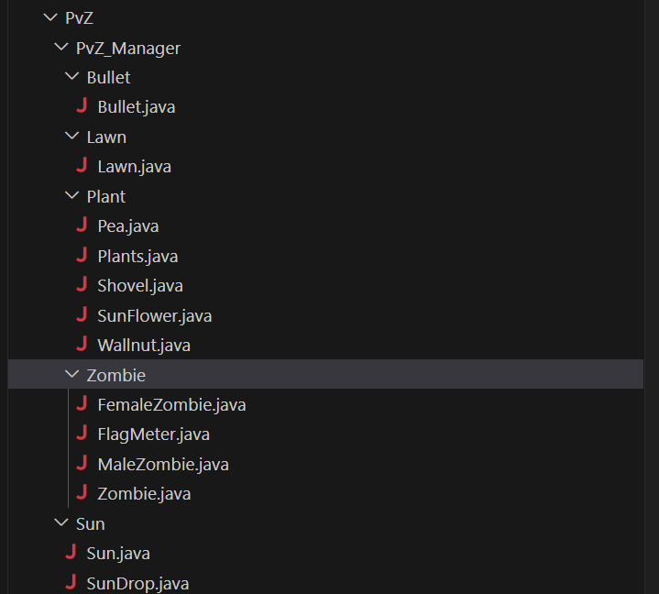
Plant and Zombies:

Slide 31
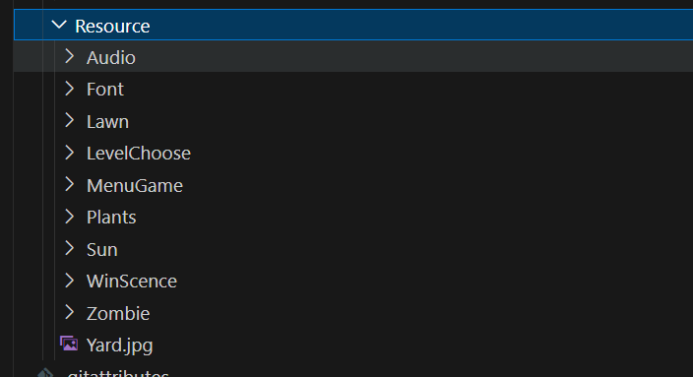
Resource:

Slide 32
CONCLUSION
The game follows OOP fundamentals and incorporates all four main OOP elements (encapsulation, inheritance, abstraction, and polymorphism).
01
In the future, have more levels with varied difficulty and improve game fluency, performance
02

Slide 33
REFERENCES
Test
GUI: https://www.youtube.com/watch?v=7GaAW-DdPuI
Solid Principle: https://www.youtube.com/watch?_jDNAf3CzeY
Mouse Listener: https://www.youtube.com/watch?v=jptf1Wd_omw&t=197s

Slide 34


THANK
YOU

